Slide 1

Color Palette

Slide 2


AustiSight
Housing Market Insights
Designed By Aman Singh

Slide 3
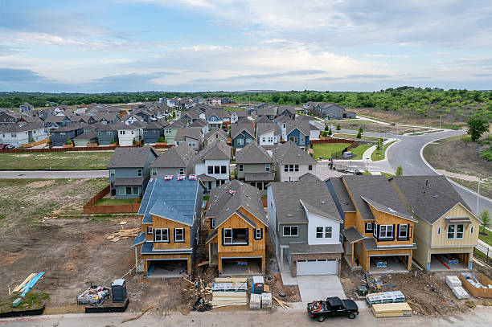
Welcome to the AUSTISIGHT Housing Market Insights Tool
This tool provides a clear, data-driven view of the Austin housing market. It brings together pricing, location, schools, and property features to support quick understanding and decision-making.
Use the navigation buttons to explore interactive views and uncover insights .
Have Fun Exploring!!
Designed By Aman Singh
AustiSight
Housing Market Insights

Slide 4
Color Theme

Slide 5













